Slide 1

INNOVATERS ARENA
PRESENTED BY
Varshini S
ISC

Slide 2
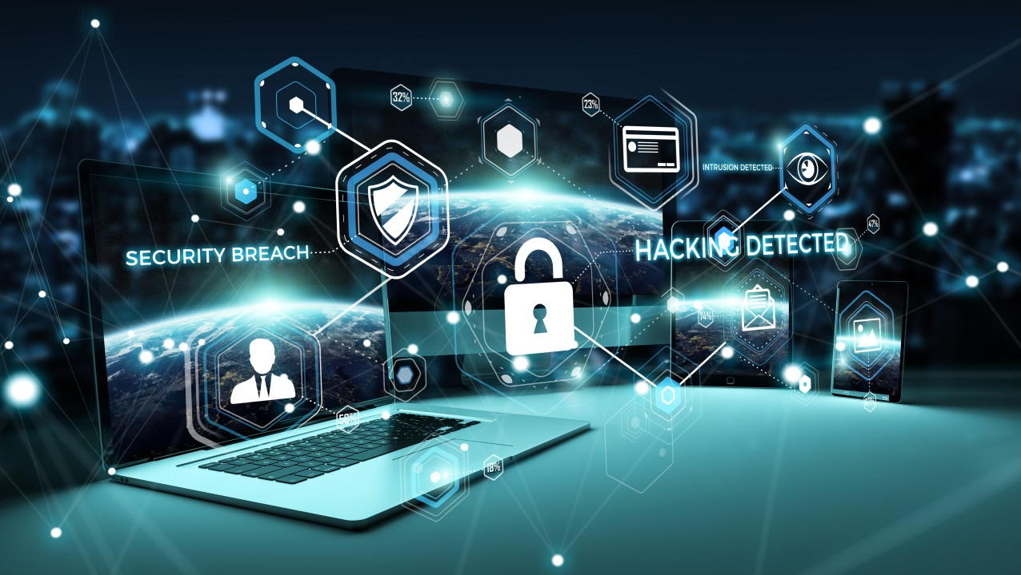
Real-time Problem In IT Sector
Cyber security breaches
A cybersecurity breach happens when an unauthorized party gains access to a company’s or individual’s data, systems, or network. These breaches can lead to:
Theft of sensitive data
Financial loss
Reputation damage
Legal consequences
COMMON CAUSES:
Weak or reused passwords
Unpatched software vulnerabilities
Phishing attacks and social engineering

Slide 3
Misconfigured cloud services
Real Example:
In 2021,Colonial Pipeline in the U.S. was hit by a ransomware attack, which disrupted fuel supply and led to a major crisis.
Solutions to prevent cyber security breaches:
1.Strong Access Control
Use multi-factor authentication to protect user accounts.
Implement role-based access, so user only access what they need.
2.Regular Security Updates & Patch Management keep software and systems up to date.
Patch known vulnerabilities quickly

Slide 4
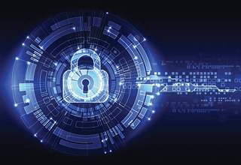
3. Employee Training Awareness
Conduct regular training on how to spot phishing emails and scams.
Run simulated phishing tests.
4. Advanced Threat Detection
Use firewalls, intrusion detection systems(IDS), and antivirus software.
Implement AI-driven tools for real time threat monitoring and anomaly detection.
5. Data Encryption
Encrypt data both at rest and in transit.
This ensures stolen data is useless without a decryption key.

Slide 5
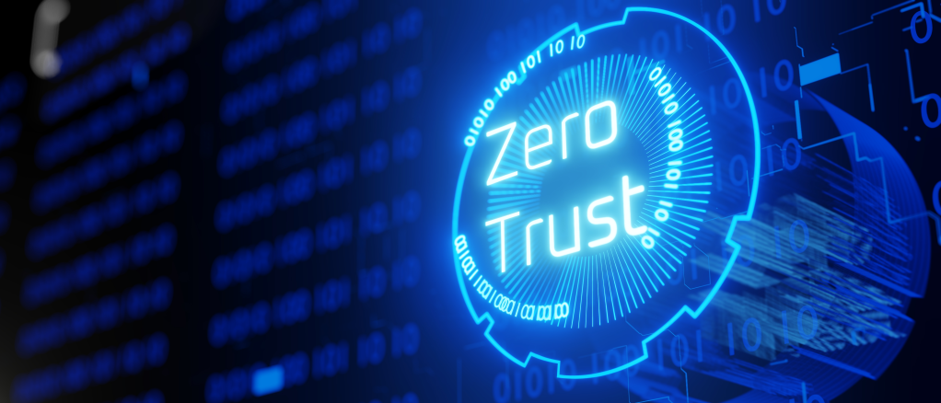
Future Enhancement:
Adoption of zero trust architecture: minimizing the risk of internal and external threats. ()
Integration of AI and Machine Learning: enhances the ability to detect the anomalies .
Enhanced Regulatory Compliance: with the increasing frequency of cyberattacks governments are updating cybersecurity regulations, urging organizations to adopt comprehensive security frameworks
CONCLUSION:
Cybersecurity breaches are growing threat that demand urgent attention.
Strengthening defenses, raising awareness , and staying updated with the latest security practises are essential to protect sensitive data and ensure digital safety.

Slide 6


